Slide 1
A Transfer Learning Approach for Malignant Prostate Lesion Detection on Multiparametric MRI
Sara Khosravi
September 2021

Slide 2




Overview
Published in 2019 in SAGE Publications
Cited 24 times
Quan Chen
Shiliang Hu
Lu Fang
Yujie Shi

Slide 3
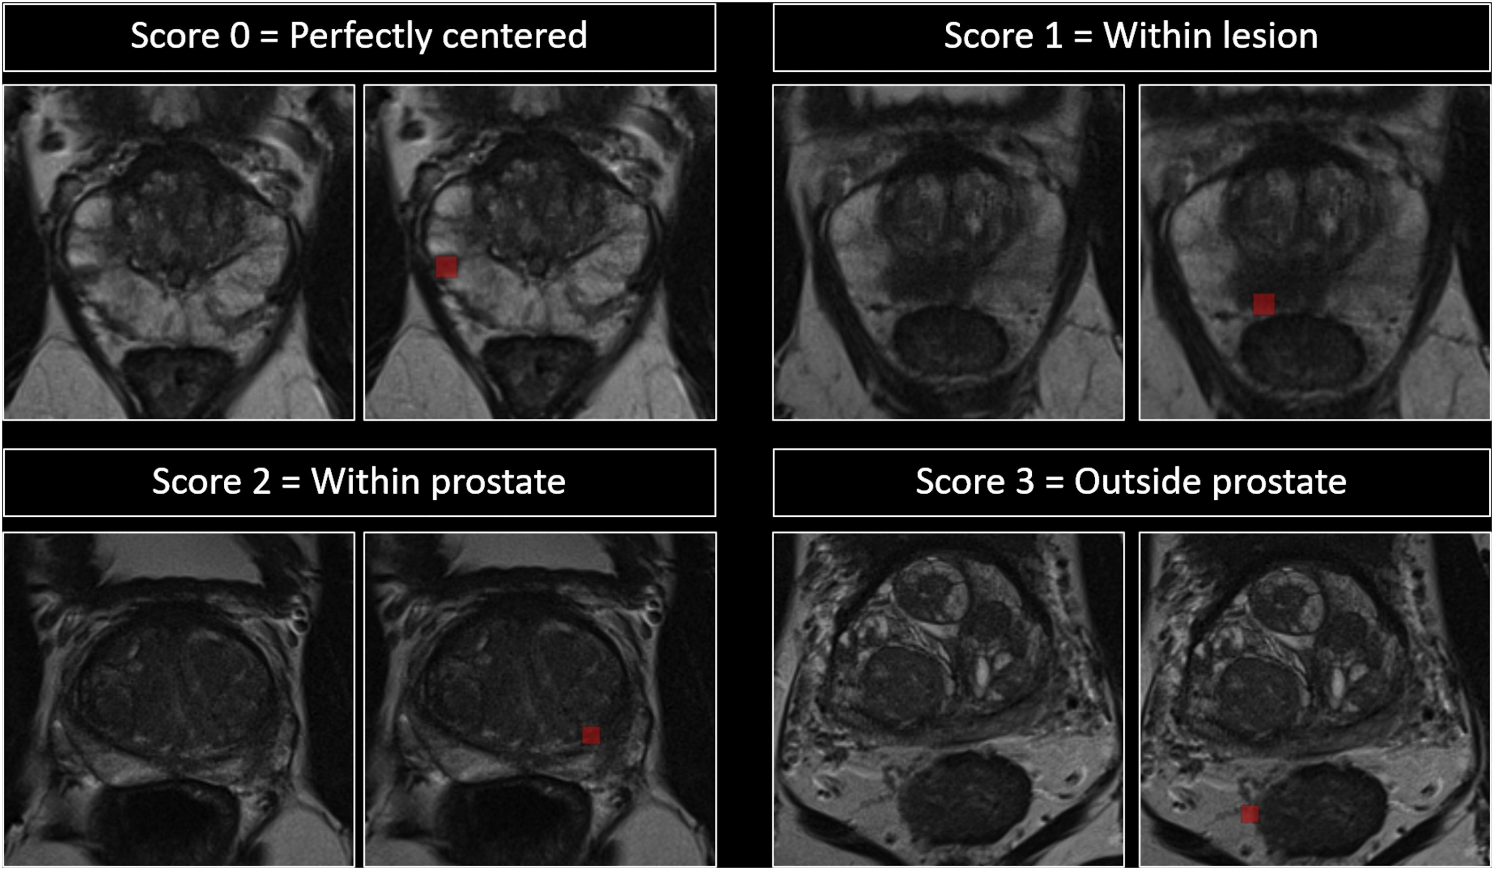
Dataset
ImageNet: 14 million pictures, with at least 500 unique images for each object
ProstateX challenge dataset
This study: only 330 training samples
Fig.10 : dataset

Slide 4
Methods

Slide 5
Preprocessing
Normalize MR intensity
Bias correction
Histogram change
Data augmentation: random rotation and translation

Slide 6
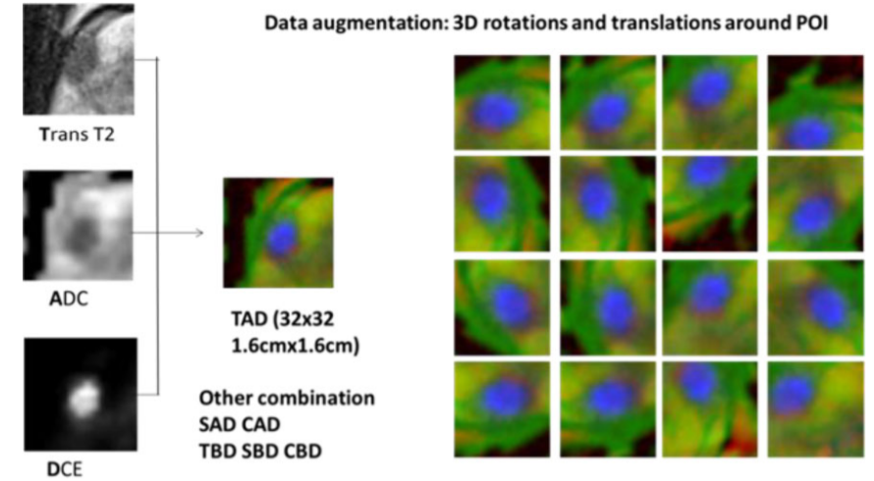
Methods and Architectures
Transfer learning
Fig.11 : Combing multiparametric magnetic resonance imaging (mpMRI) images into RGB channels and augmentation with random rotation and translation

Slide 7
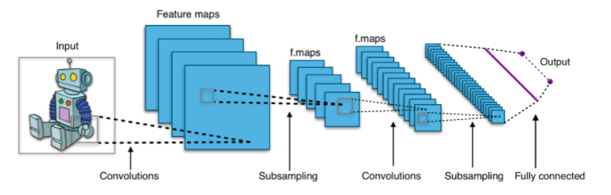
Methods and Architectures
DCNNs: InceptionV3 and VGG-16
Fig 12: DCNNs

Slide 8
Inception
Previous Inception models problems
Inception V3
auxiliary classifiers didn’t contribute much until near the end of the training process, when accuracies were nearing saturation.
RMSProp optimizer
Factorized 7x7 convolutions
BatchNorm in the auxillary classifiers
Label Smoothing: a type of regularizing, prevents over fitting

Slide 9
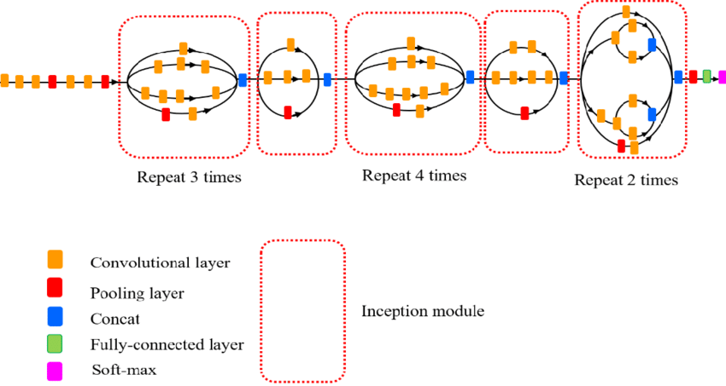
Fig.13 : Inception v-3

Slide 10
VGG-16
The 16 in VGG16 refers to it has 16 layers that have weights.
Pretty large network with about 138 million parameters
Instead of having many hyper-parameters, have convolution layers of 3x3 filter with a stride 1 and always used same padding and maxpool layer of 2x2 filter of stride 2.
It follows this arrangement of convolution and max pool layers consistently throughout the whole architecture.
In the end it has 2 FC, followed by a softmax for output.

Slide 11
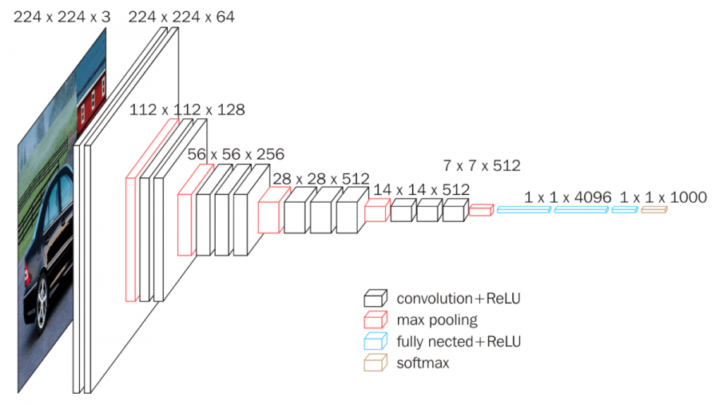
Fig 14: vgg

Slide 12
Postprocessing
Ensemble learning: reduce both bias and variance
For each model: average the scores of 50 augmented images with fixed translation and rotation of the same lesion as the model output.
For each prostate zone: pick the 2 best performing models based on the validation data set.
For each lesion in the test data set: average the prediction from the 2 best performing models.

Slide 13
Evaluation

Slide 14
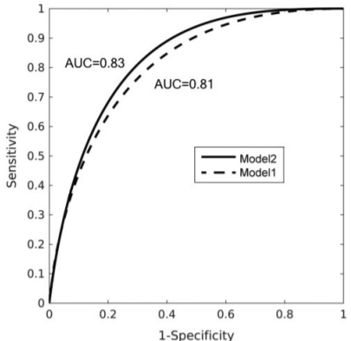
Results
AUC: 0.81 to 0.83
Cross Entropy Loss used
Fig. 15 : Results

